Slide 1
Object Recognition In Driverless Car

Slide 2
ABSTRACT
Object recognition is a crucial component of driverless cars, enabling them to detect, identify, and respond to objects around them, such as vehicles, pedestrians, and road signs.
In this project, we leverage the YOLOv (You Only Look Once, versioned) deep learning model for real-time object detection and recognition in autonomous vehicles.
YOLOv is known for its speed and accuracy, essential for real-time applications in complex and dynamic environments like roadways.
This project explores how the YOLO model uses deep learning concepts to perform rapid, precise object detection
To Help driverless cars make safe driving decisions instantly.

Slide 3
SYSTEM REQUIREMENTS
HARDWARE REQUIREMENTS
Cameras: Capture Images to identify objects on the road.
SOFTWARE REQUIREMENTS
YOLOv Library: A pre-trained object detection model known for its real-time accuracy.
Deep Learning Frameworks: Libraries such as TensorFlow, PyTorch, or Darknet (the original YOLO framework) for training and deploying YOLO models.

Slide 4
PURPOSE OF THE SYSTEM
The goal of using the YOLOv model in driverless cars is to enable:
Real-Time Object Detection: Recognizing and locating objects around the car with high speed and accuracy.
Safe Navigation: Using YOLO’s predictions to make instant decisions, avoid accidents, and follow traffic rules.
Effective Response to Dynamic Environments: Adapting to changing road conditions and different types of objects in the surroundings.

Slide 5
Deep Learning Concepts Used in YOLO
YOLO uses several deep learning techniques, such as convolutional neural networks (CNNs) and feature extraction, to achieve high performance. Here are some key deep learning concepts YOLO leverages:
Convolutional Neural Networks (CNNs):
YOLO is based on CNN architecture, which processes input images by extracting relevant features, like shapes and textures, necessary for object recognition.
The CNN in YOLO scans the entire image in one pass (or "single shot") to detect objects, rather than dividing the task into multiple stages like older models (e.g., R-CNN).

Slide 6
Advantages of YOLO for Driverless Cars
Speed:
YOLO’s single-pass, grid-based detection is extremely fast, making it ideal for real-time applications in autonomous vehicles.
Accuracy:
YOLO’s high accuracy in detecting objects allows for precise classification, essential for safe navigation.
Efficiency in Complex Environments:
YOLO handles multiple objects simultaneously, which is vital for autonomous driving in busy, complex environments.

Slide 7
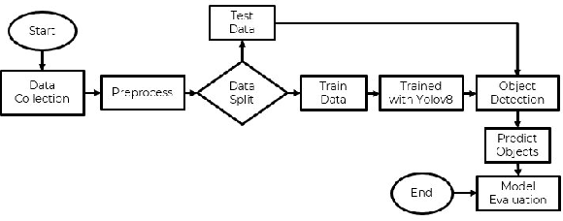
BLOCK DIAGRAM

Slide 8
Challenges of YOLO in Autonomous Driving
While YOLO offers several advantages, there are challenges when using it in driverless cars:
Limited Detection of Small or Distant Objects:
YOLO may struggle with smaller or far-away objects, which can be critical for highway driving.
Sensitivity to Lighting and Weather Conditions:
Poor lighting, fog, or rain can affect YOLO’s performance, as it relies heavily on camera input.
Complex Scenes:
In highly crowded areas, YOLO might miss or misclassify objects due to overlapping detections.

Slide 9
Conclusion
Using YOLO for object recognition in driverless cars provides a powerful, deep learning-based solution for real-time object detection. YOLO’s single-shot design and CNN-based architecture make it ideal for fast, accurate object detection, enabling driverless cars to make quick and safe driving decisions. While there are still challenges to overcome, YOLO’s advancements are paving the way toward safer and more reliable autonomous vehicles. By leveraging YOLO’s deep learning capabilities, driverless cars are getting closer to achieving fully autonomous driving in real-world environments.

